Slide 1

TEAM
Presented by:
Shubham Aggarwal : Komal Parekh : Nikhil : Rutuja: Sreeja: Dinesh: Harshida

Slide 2
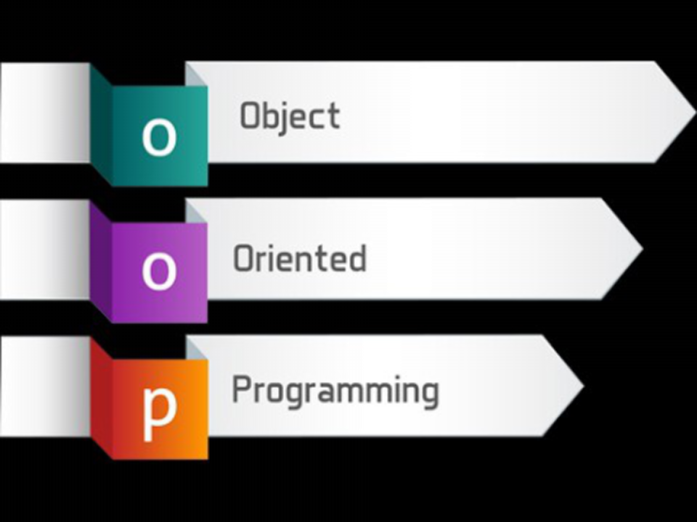

Slide 3

WHY OOPS??

Slide 4
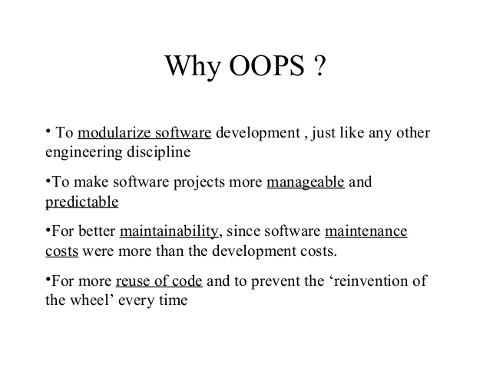

Slide 5
History of OOPS
STIMULA
SMALLTALK
C++ 1970S
JAVA 1990

Slide 6
BENIFITS OF OOPS

Slide 7
What you can expect in next slides

Slide 8
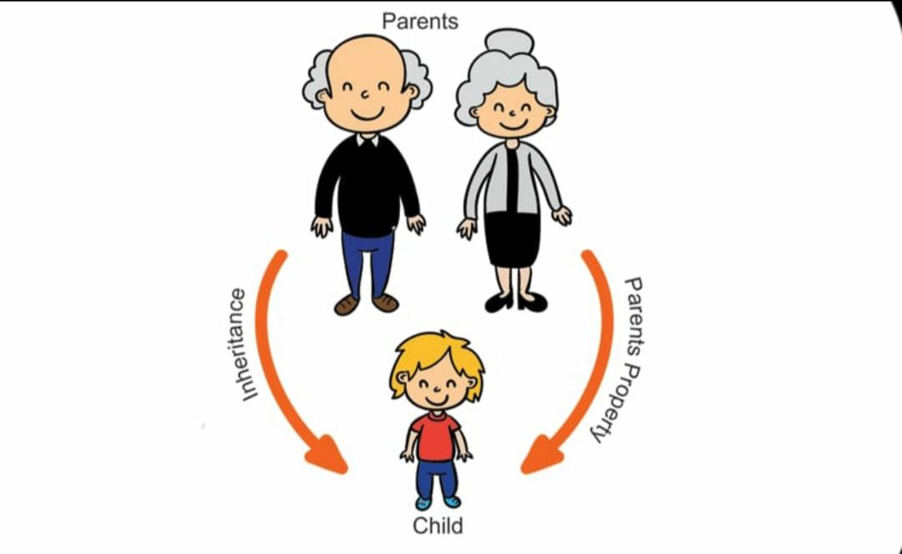
Inheritance

Slide 9
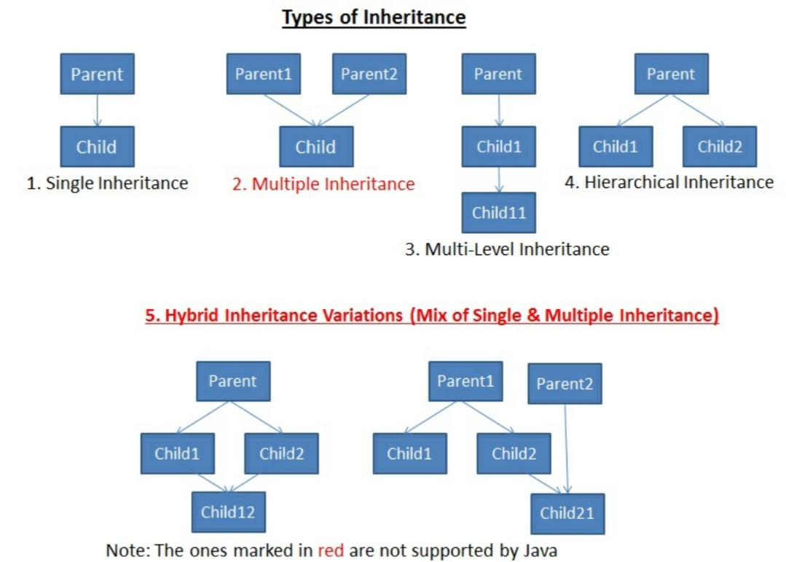

Slide 10
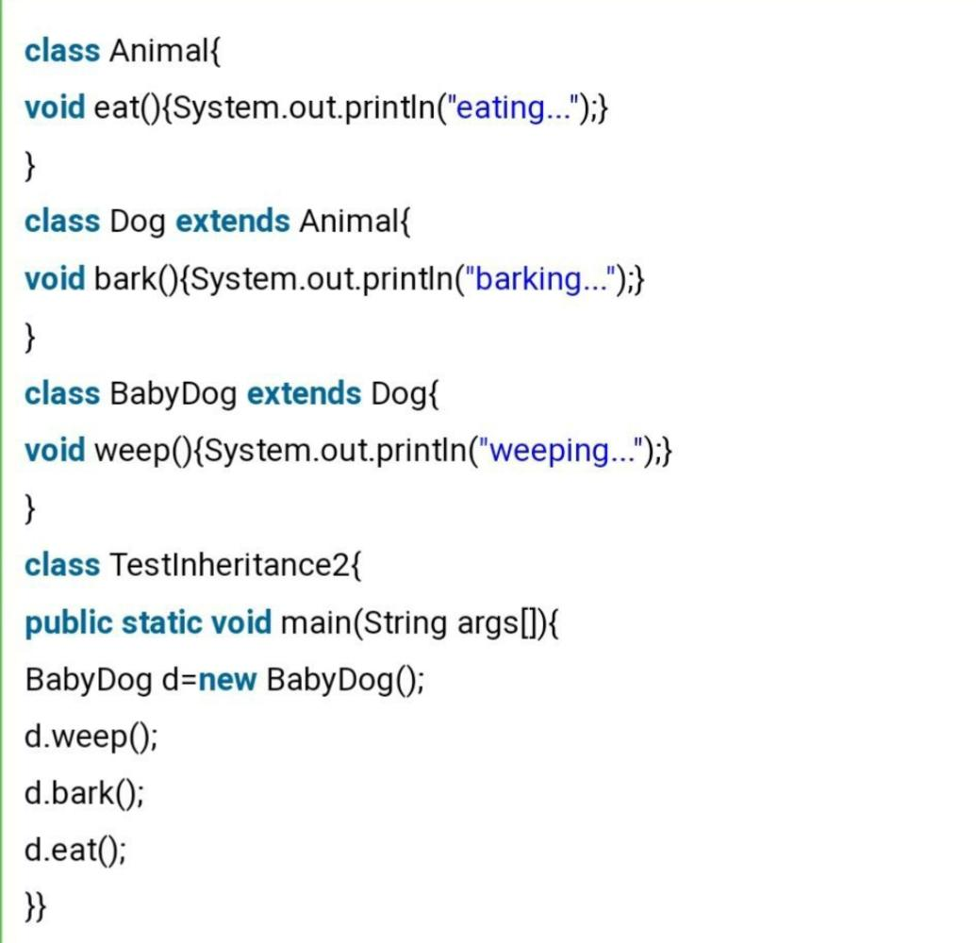
Program Example :-

Slide 11
polymorphism
Types of polymorphism
Run time
Compile time

Slide 12
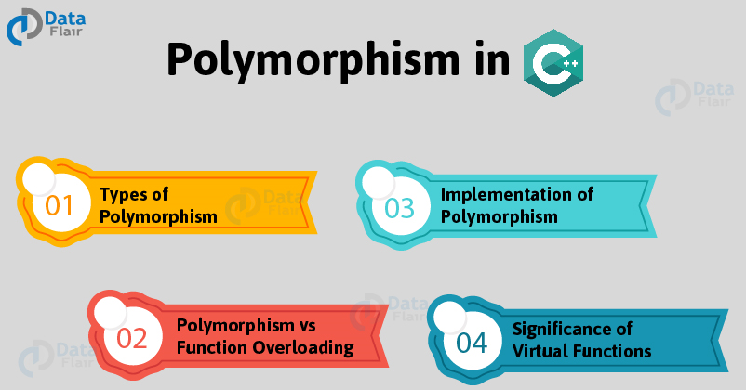

Slide 13
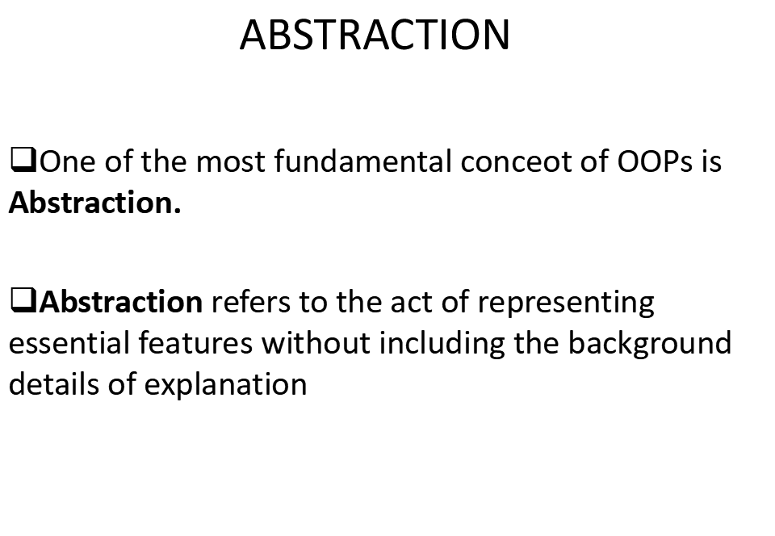
Abstraction

Slide 14
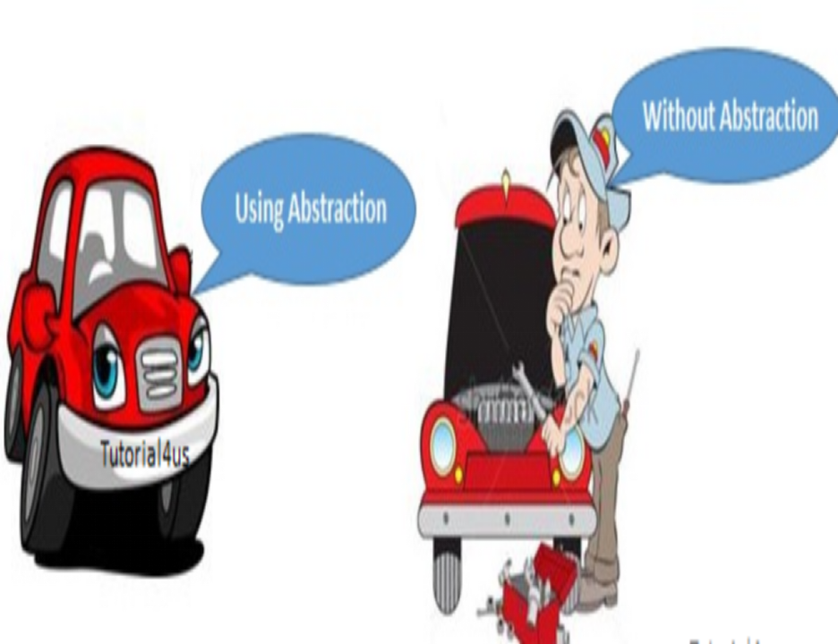

Slide 15
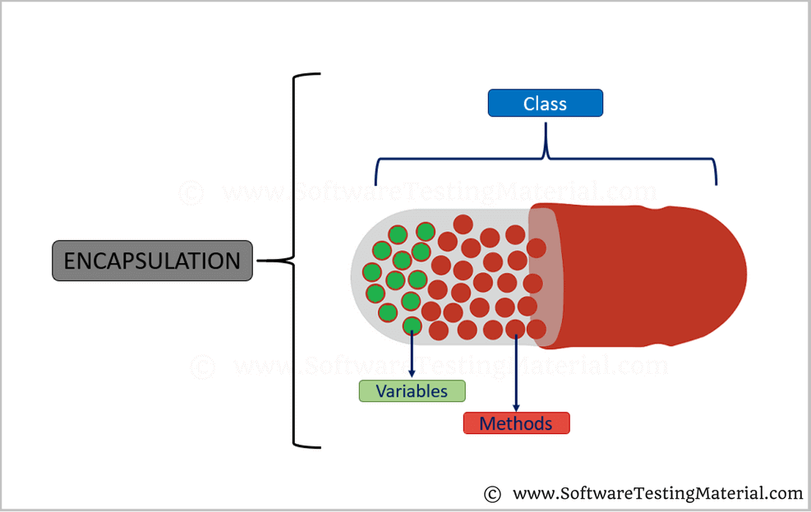
Encapsulation
Wrapping of code and data into a single unit by making the data members private and which are only accessible by the public methods in the class

Slide 16
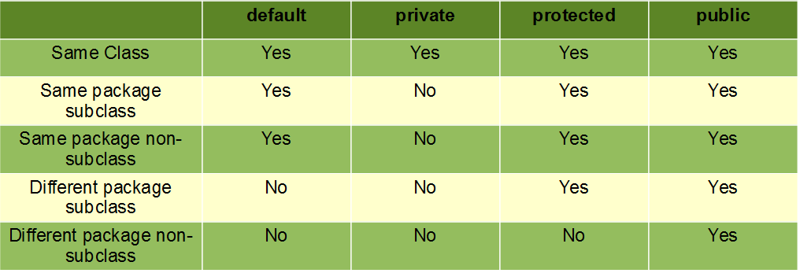
Access Modifiers
Access modifiers in Java helps to restrict the scope of a class, constructor , variable , method or data member.

Slide 17
Getters and Setters
Get methods return the variable value.
Set methods set the variable value.
public class Person {
private String name; //private data field
public String getName() { // Getter method
return name;
}
public void setName(String newName){ //Setter method
this.name = newName;
}}

Slide 18
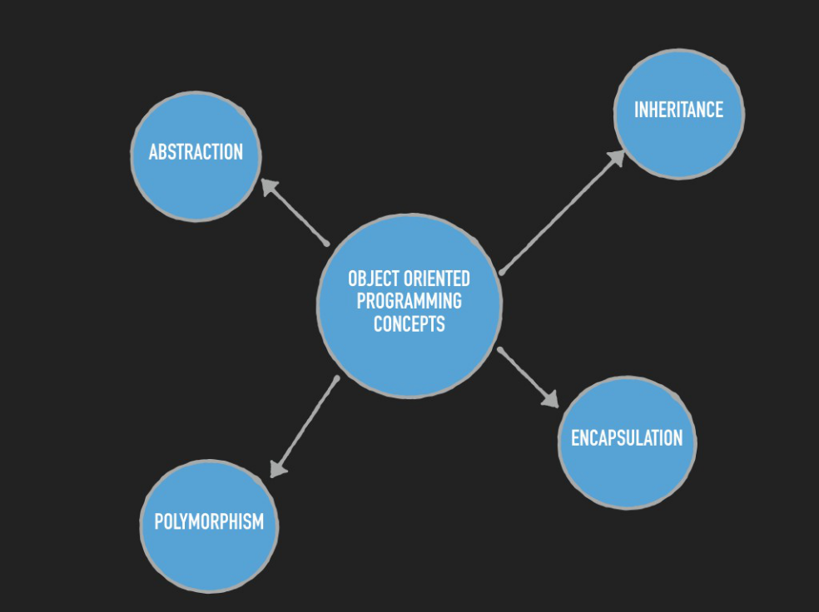

Slide 19
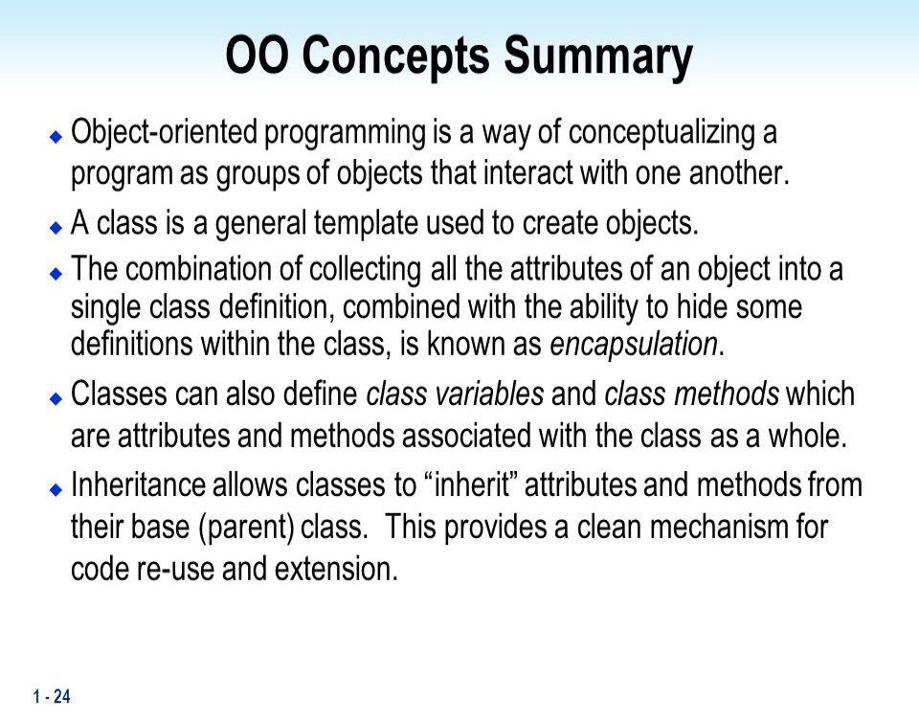

Slide 20
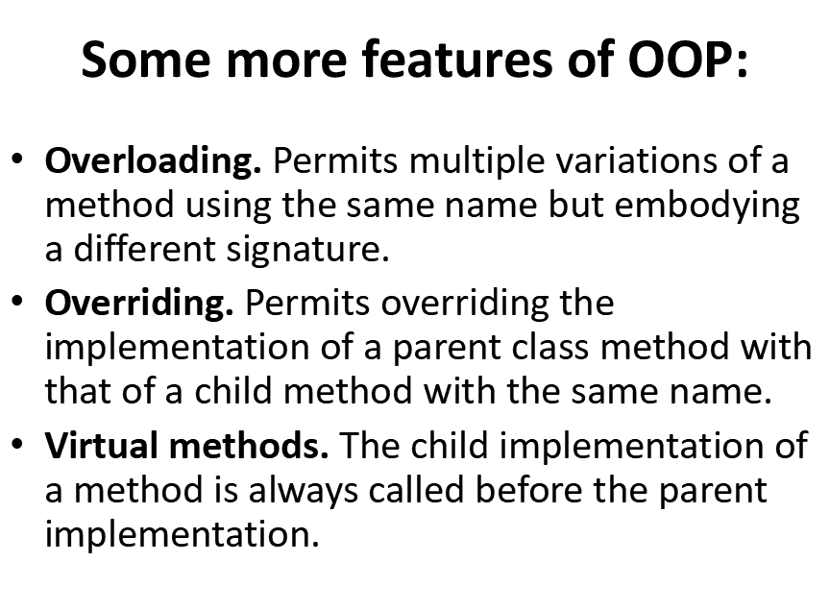

Slide 21
Thank you

